Slide 1
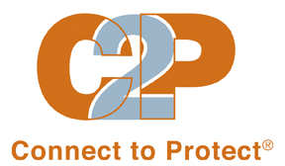
Structural Change
April 2014

Slide 2
Training Goals
Gain understanding of the C2P mobilization model
Learn concepts of structural change and practice identifying structural changes
Strategize around enhancements to local C2P Strategic Plan targeting barriers along the HIV Care Cascade

Slide 3
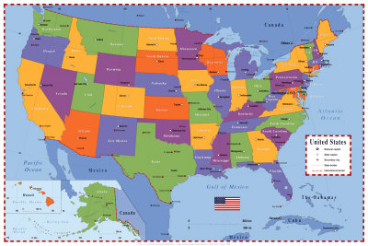
Connect to Protect® Nationwide
Boston
Detroit
Bronx
Philadelphia
Baltimore
Chicago
DC
Los Angeles
Denver
New Orleans
Tampa
Memphis
Houston
Miami
Notes:
You may recall, there are currently 14 C2P coalitions located across the country all focused on creating structural changes to reduce HIV rates among a specific youth population.
9 (CLICK MOUSE) formed in 2006, and (CLICK MOUSE) the other 5 formed at the end of 2011. Half focused on young women who have sex with men as their target population and the other half focused on young men who have sex with men. Several coalitions also include transgender youth as part of their focus.
Though as you can imagine structural level changes such as a new policy requiring comprehensive health education in schools will have implications for youth beyond the coalitions; target population.
Today, there are more than 250 structural changes achieved across all coalitions & countless activities to elevate community engagement around HIV prevention. C2P is considered the ‘go-to’ community organization in many communities for youth/HIV.

Slide 4
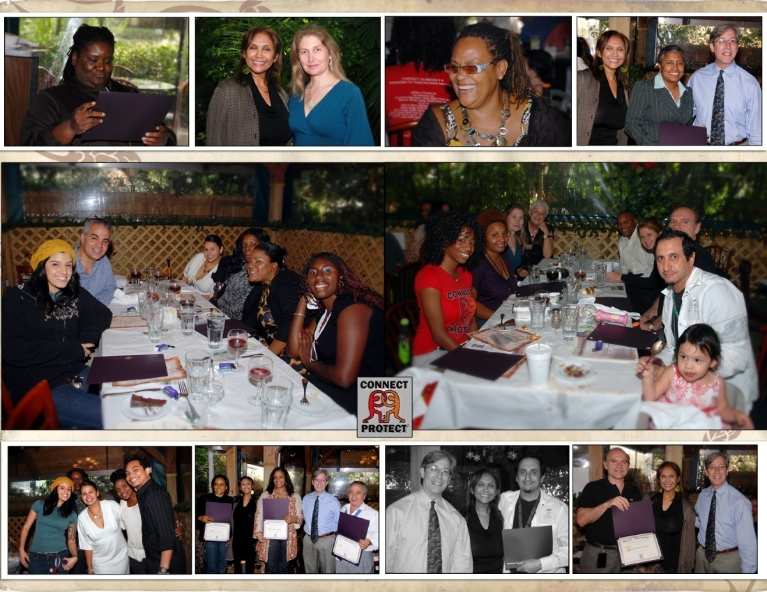
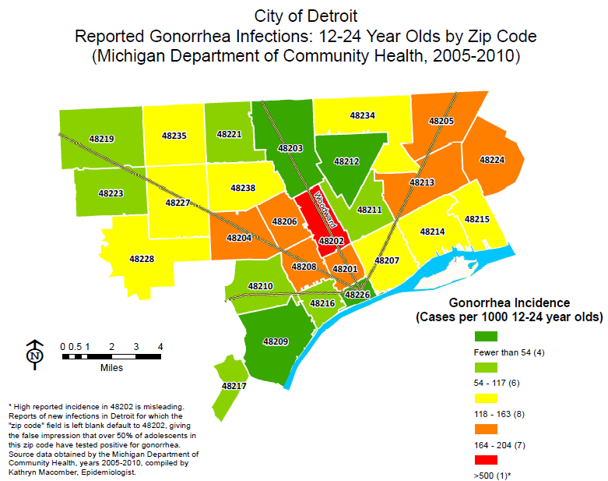

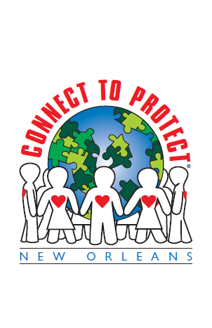
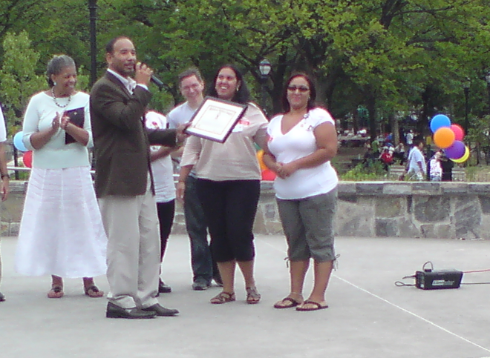
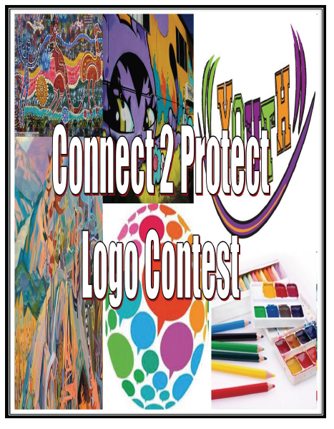
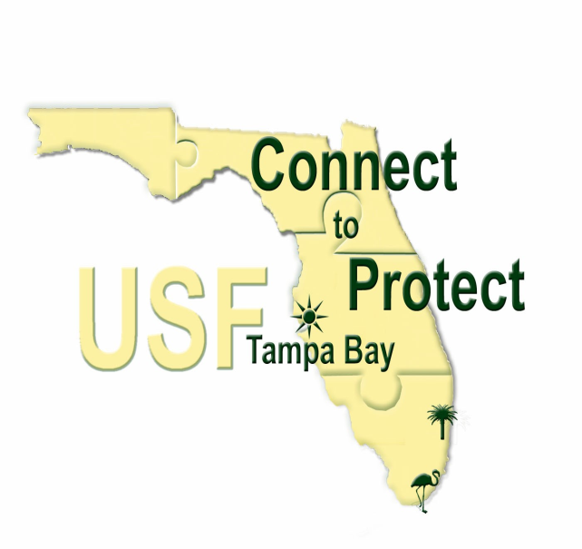
“City Hall Recognizes LGBT Homeless Youth”
Philadelphia Gay News, Nov. 2011
“LGBT youths in Washington area get their first mentoring program”
Washington Post, June 6, 2012
“Chicago Department of Public Health and Community Partners Expand HIV Hotline for Adolescents”
Press Release, July 17, 2012
Notes:
C2P looks different in each city – groups take on their own personality and their own ways of functioning but all of them are active groups – they are not planning councils nor advisory boards. They are in the community talking with people, making connections and finding ways for the coalition to be a force of change.
Top left: pictures from a C2P Miami gathering - the coordinator there always host an end of the year celebration with awards for coalition members. It’s festive and an important way to recognize partners.
Headline from the Wash Post – this was a big one for the DC coalition. They worked for a couple years on this objective that now establishes a mentoring program –through a community partner organization – for LGBT youth.
Also included examples of coalition logos – most of the coalitions wanted to establish their local identify and a logo is a nice way to do that and an easy/fun way to engage partners early in the process.
The picture in the middle is of the C2P Bronx coalition receiving an award from XXXX
A couple other headlines Philly Gay News and Chicago HD press release reflect the work of C2P.
Finally, the map in the upper right corner is a required component of C2P – collect local STI/HIV data and use GIS software to visually depict morbidity rates – this helped with focusing their planning efforts and the maps became a wonderful tool to share with the community.
Convey the VITALITY of coalitions that blossomed over the years

Slide 5
Defining Mobilization
Mobilization is the process of collaborative problem-solving resulting in changes to the environment that lead to reduced health and/or other social problems and, ultimately, to healthier communities

Slide 6



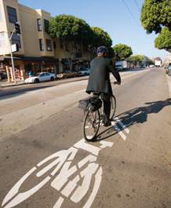

Familiar Structural Changes
Notes:
You are probably very familiar with structural change – you may not have the exact words to define it – but it’s all around you.
We’ve been through decades of change around smoking – lots and lots of effort put toward smoking cessation programs but that was coupled very effectively with sweeping policy changes that altered where a person could smoke – not in public places, not on airplanes, not in restaurants….
In the mid-80s, states were essentially told that unless they passed seatbelt laws there wouldn’t get their transportation/highway funding from the federal gov’t. That’s a huge structural change.
And then we see changes to the physical environment to promote better health outcomes – roads were changed to allow space for bikers. Bins are now set out for recycling in offices and public places…
And many schools offer healthier lunches for kids…

Slide 7
C2P Structural Change
… new or modified programs, policies and practices
  Logically linkable to HIV acquisition and transmission.
  Can be sustained over time, even when key actors are no longer involved.
  Changes may directly or indirectly impact individuals.
  Can also be changes to the physical structures of the built environment (i.e. abandoned buildings, poorly lit parking lots)
Notes:
C2P definition…

Slide 8
Causes & Contributors of Risk
Macro Level
Racism, Stigma, Poverty, Gender Inequality, Migration
Structural Level
Resource availability
Physical Environment
Organizational Systems
Laws/Policies
Community Level
Networks
Social Capital/ Collective Efficacy
Relationships
Community Norms
Individual Level
Behavior
Attitudes
Knowledge
Perceptions
Biology
Individual Susceptibility
Notes:
Structural change is one approach the field of public health utilizes to address risk. We can break down the causes and contributors of risk in four different ways.
There are individual level contributors related to an individual’s behavior, knowledge, attitude etc…
There are causes associated with community norms, social networks and relations that people have, peer pressure even
Then there are causes tied into the environment in which we live, the physical structures, availability of resources, laws and policies, practices within organizations and physical structures.
**Finally there are causes that are much bigger than our coalition can solve such as racism, stigma, poverty, gender inequality….

Slide 9
Types of Interventions
Impact
Types of Interventions
Examples
Smallest Impact
One-on-one counseling, educating adolescents
Individual & Small Group
MPowerment, StatusSexy.com
Community-Level
Structural-Level
Policies, practices, laws, systems
Socioeconomic Factors
Racism, poverty, sexism
Largest Impact
Notes:
In the same way, there are different types of interventions we can think about to address risk.
You can see that the pyramid shows the layers of intervention and examples of the types of change or targets for change within each layer.
What I like about this, is the scale on the left showing the degree of impact each type of intervention is likely to have in terms of reaching more people and being more broadly applied in the community.
This doesn’t mean that individual and community level interventions become obsolete. A structural intervention should strengthen the potential for a community level or individual level program to affect change.

Slide 10


The River Metaphor
Notes:
Let’s use an example of a river to illustrate the effect of intervening at the structural level. Imagine a river. The current is strong, and the only way to reach the other side is by a bridge. The bridge is broken, and people who try to cross keep falling into the river. CLICK
There are people on the shore who see this and attempt to rescue the victims. First, they run downstream and pull individuals from the water one by one. People are being saved from drowning, but it’s hard work to reach everyone. CLICK
The problem is that the bridge is still broken, and people continue to fall into the river and fight for their lives. CLICK
Prompt: At what level is the response? (individual-level intervention)

Slide 11
The River Metaphor
Watch your step
Broken Bridge
Cuidado!
Notes:
The rescuers begin to get tired and do not see an end in sight. Then someone has an idea – to warn the people crossing the bridge that it is broken by posting signs. CLICK
The community begins a campaign to make people aware of the dangerous bridge. A couple of people manage to cross the bridge safely, CLICK but most do not even see the signs. CLICK The rate of people falling into the river remains high.
Prompt: At what level is the response? (community-level intervention)

Slide 12
The River Metaphor
Notes:
The community is frustrated by now. At last someone says, “Why don’t we just fix the bridge?” Finally, they repair the bridge and everyone can cross the bridge safely. CLICK 2Xs
In real life, in may not be that easy to “fix” the problem – there are always many issues to sort through: who decided on the materials to use? Who made the repairs? Who funded the bridge-renewal project? Which side of the river claimed the success? – but, nevertheless, the impact is huge. No one drowns.
Looking upstream to fix the root of the problem, is perhaps the simplest way to describe a structural change. In the river metaphor the focus was on introducing the concept of where to intervene. The example that saved the most lives was the one that intervened on a structural level.
Relating the River Analogy to HIV Prevention
Think about young people (target population) in your communities; falling into the river of HIV infection –or the risk environment - at record rates… some make it out but many others are drowning… We have to ask ourselves three important questions:
1. Why are these young people falling into the river OR why are these young people becoming infected?
2. Where along the river do we need an intervention?
3. What type of intervention will be most sustainable?
Remind folks that there is not just one place along the river to intervene, but many places; that is, it will take lots of structural changes to ‘build the bridge’.

Slide 13
Comparing Types of Change
Individual-Level Change
Structural-Level Change
Focus on behavior change
Focus on relationship between individual & HIV-related problems (i.e., poor condom use)
Short-term focus on program development
Individual not a decision-maker
Individual as audience
Focus on practice/policy change
Focus on social, political & economic context related to HIV-related problems
Long-term focus on policy development
People gain power by acting collectively
Individual as advocate
Adapted from The Coalition Impact: Environmental Prevention Strategies. CADCA’s National Coalition Institute

Slide 14
Example
Problem: Young women are being infected by partners recently released from local Juvenile Correctional facilities who are unaware of their status.
Individual Intervention: Young women are taught condom negotiation skills
Community Intervention: Launch a media campaign about the risk of unprotected sex
Structural Intervention: New policy at Department of Juvenile Justice (DJJ) requiring all arrested individuals to receive HIV/STI counseling & testing
Notes:
Let’s take an actual problem that was discussed and addressed by the C2P: Miami coalition and illustrate the three different ways it could be addressed depending on the type of intervention pursued.
The individual level - TARGETS the Individual (Young women) – to teach a skill, increase knowledge or change behavior.
The community level - TARGETS the community to change norms about relationships that may impact individual outcomes.
At the structural level – the TARGET of the change is the Department of Juvenile Justice and its policies affect change across the entire system and does not depend on the individual to alter his/her behavior.

Slide 15
STRUCTURAL CHANGE
Structural changes are new or modified programs, practices or policies that are logically linkable to HIV transmission and acquisition and can be sustained over time, even when key actors are no longer involved. These changes may directly or indirectly impact individuals
Logically linkable to HIV transmission and acquisition:
The structural change objectives must be logically linkable to long-term objectives
Programs, practices or policies:
Programs- any program or service
Practices- the way things are done
Policies- written or unwritten guidelines
Key actors:
Key actors are those who exerted pressure to make the change happen, including the C2P coalition itself
Key actors may continue their involvement, but the sustainability of the structural change does not depend on their continued involvement.
Sustainability:
Once the change has been achieved, the effect of the change is likely to persist, AND
There is a supporting infrastructure in place - independent of the C2P coalition or C2P related resources - that increases the likelihood that the change will be maintained
Directly or indirectly impact individuals:
Some changes directly target individual behavior, such as a policy requiring individuals to use condoms in bathhouses
Other changes directly target a feature of the environment

Slide 16
What is a program?
A set of ongoing
organized
activities
with a desired
outcome
In 2008, five CBOs serving young women in high risk areas of the Bronx incorporated comprehensive sex education, including HIV prevention, into their existing activities.

Slide 17
What is a practice?
In December 2009, DC Department of Human Services began to require its grantees to adhere to a list of LGBT cultural competency best practices prior to receiving funding
A standardized
action or manner
of doing
something

Slide 18
What is a policy?
Guidelines that
regulate the
environment and/or
the individual
within the
environment
In August 2007, the School District of Hillsborough County amended its policy and began to allow HIV and STI testing on school grounds

Slide 19
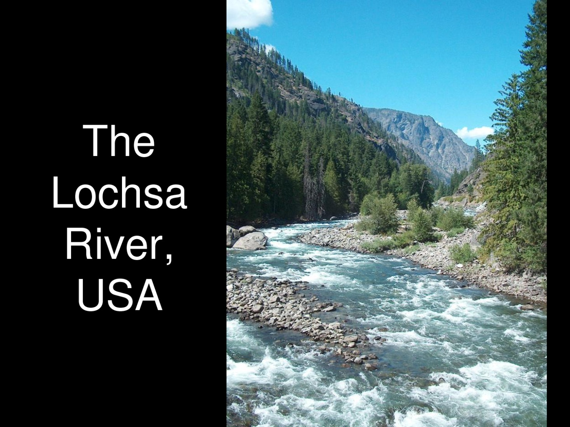
Thinking ‘Up River’ About Structural Change

Slide 20
Continuum of Care Accomplishments to date…
A total of 220 SCOs have been initiated; 98 have been completed!
All C2P coalitions have established subcommittees dedicated to addressing youth LTC barriers in their communities
Notes:
as members/co-chairs of these subcommittees

Slide 21
HIV Treatment Cascade | Barriers Identified | Structural Change Objective (SCO) Initiated
HIV Testing /Diagnosis | Barrier: Lack of HIV testing of incarcerated youth (Miami) Barrier: Lag time between donation & diagnosis at local Blood Bank resulting in loss to follow (Memphis) Barrier: State issued ID (i.e., driver’s license) required to obtain HIV test result (Memphis) Barrier: Limited access to outpatient counseling services without parental consent (Miami) | SCO: Florida Department of Health registered the Juvenile Assessment Center as an HIV testing site to begin identifying and tracking HIV+ youth within local correctional facilities SCO: Shelby County Health Department designated staff as point of contact for all HIV+ donors from the Interstate Blood Bank, to expedite and streamline communications and reduce risk of HIV+ donors becoming loss to follow. SCO: Shelby County Health Department changed policy to begin accepting alternate identifiers from individuals seeking test results SCO: By December 2015, the State of Florida will pass an amendment to public health statute 384.30 (chapter 384- sexually transmitted diseases) to include "minors access to counseling services" allowing at risk and/or HIV/STI infected minors to consent to outpatient counseling services without parental consent.

Slide 22
HIV Treatment Cascade | Barriers Identified | Structural Change Objective (SCO) Initiated
Linked to Care | Barrier: Limited LTC data sharing procedures (Chicago) Barrier: Delay in establishing eligibility with LHD as the only entity qualified to verify Ryan White eligibility (Memphis) Barrier: Ryan White requirement of proof of income eligibility from minors prohibited youth LTC (Miami) The Tampa site adopted the Miami SCO and expanded to 7 other counties. Barrier: Lack of standardized procedures to ensure HIV+ youth linkage to care(DC) | SCO: By June 2015 the Chicago Department of Public Health created a Linkage to Care Specific Database for youth 13-24 to ensure continuity of care SCO: Shelby County Health Department modified policy to allow other youth service providers to be responsible for verification of Ryan White eligibility. SCO: Miami-Dade County Office of Management and Budget Grants Coordination changed practice and began using a statement of no income document for HIV+ up to age 25, to access case management and medical care services under the Ryan White Program. SCO: Hillsborough County Health & Human Services Ryan White Administration amended Service Delivery Guidelines to exempt HIV+ minors (12-17) and young adults (18-26) from providing income eligibility(change adopted in Hernando, Pasco, Pinellas, Manatee, Polk, Hardee, and Highlands Counties) SCO: By June 2014, the DC Department of Health will establish protocol for CBOs and community health centers around linking HIV+ youth to care.

Slide 23
HIV Treatment Cascade | Barriers Identified | Structural Change Objective (SCO) Initiated
Linked to Care | Barrier: : Lack of formalized procedures to insure HIV+ youth are linked to care (Miami) | SCO: Miami-Dade County Public Health Department, Office of HIV/AIDS, amended their memorandum of agreement (MOA) with DOH's HIV counseling and testing sites/agencies to include language requiring linkage to care and treatment services to HIV positive clients as part of their service delivery.
Engaged/ Retained in Care | Barrier: Limited access to long term health care (Los Angeles) Barrier: Youth are falling out of care at transition. (Los Angeles) Barrier: Lack of culturally competent linkage, engagement and/or transitional services for HIV+ youth.(Boston) | SCO: Los Angeles County Health Department established screening protocols to be utilized by Ryan White Care providers in establishing eligibility for appropriate health care coverage options including Healthy Way LA. SCO: Office of AIDS Program and Policy adopted a new policy outlining transitional case management services for HIV positive youth for funded contracting agencies. SCO 32: By May 2014, MA Department of Public Health Disease Intervention Specialist (DIS) will refer HIV/STI co-infected youth who are not engaged in care to The Fenway Institute’s youth LTC program. This practice change will allow HIV+ youth who are not currently engaged in care to receive personalized youth specific linkage, engagement and retention services.

Slide 24
Resources
Coalitions and Partnerships in Community Health by Frances Dunn Butterfoss
The Community Tool Box http://ctb.ku.edu/en/default.aspx
CADCA Community Anti-drug Coalitions of America
http://www.cadca.org/

